Slide 1
Networking and Internetworking Devices
Repeaters
Bridges
Routers
Gateways
Routing Algorithms

Slide 2
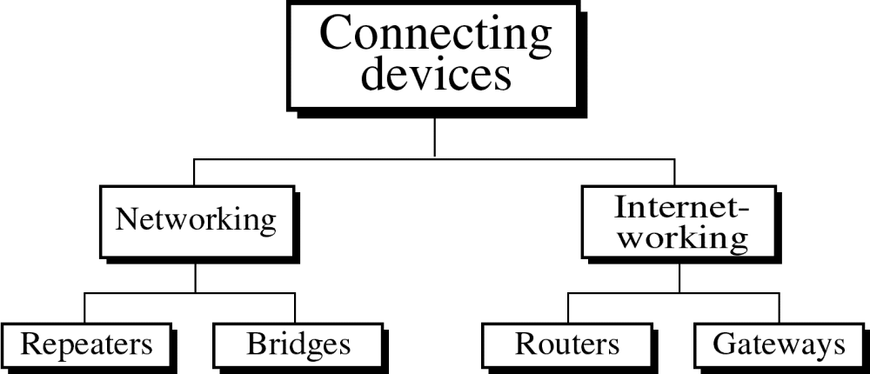

Slide 3

Connecting Devices and
the OSI Model

Slide 4
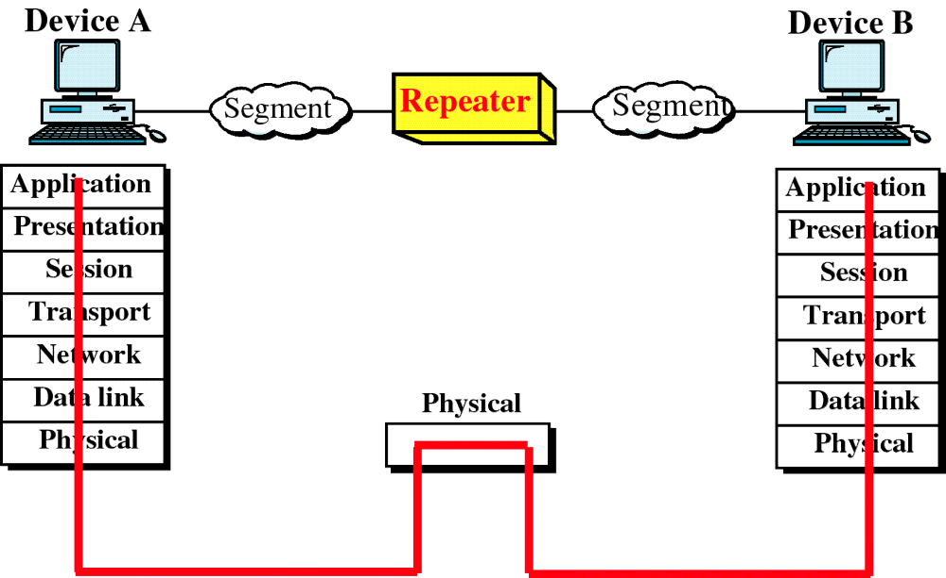
Repeater and OSI Model
WCB/McGraw-Hill
© The McGraw-Hill Companies, Inc., 1998

Slide 5
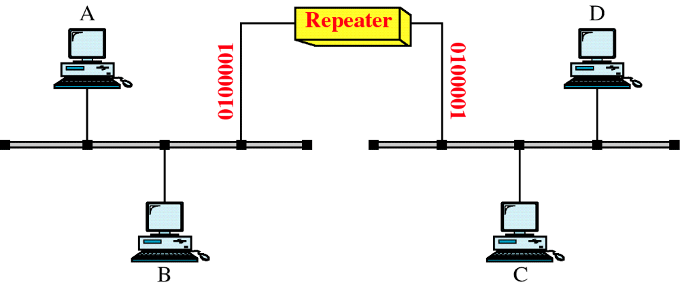
A Repeater
WCB/McGraw-Hill
© The McGraw-Hill Companies, Inc., 1998

Slide 6
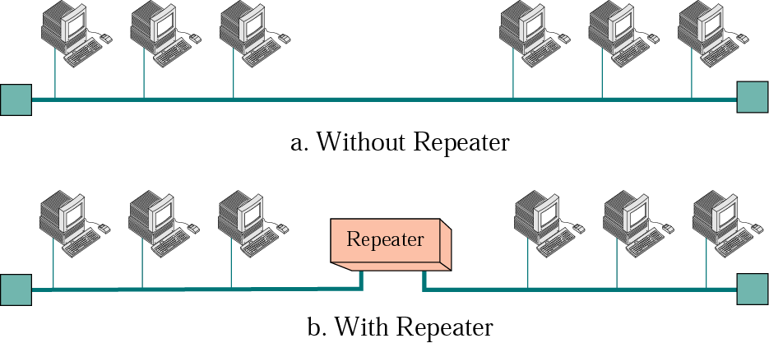
Repeater
A repeater is an electronic device and operates only in the physical layer of the OSI model.
A repeater can regenerate the signal and send it to the rest of the network.

Slide 7

A repeater connecting two segments of a LAN
15.<number>

Slide 8

Note
A repeater connects segments of a LAN.
15.<number>

Slide 9
Note
A repeater forwards every frame;
it has no filtering capability.
15.<number>

Slide 10
Note
A repeater is a regenerator,
not an amplifier.

Slide 11
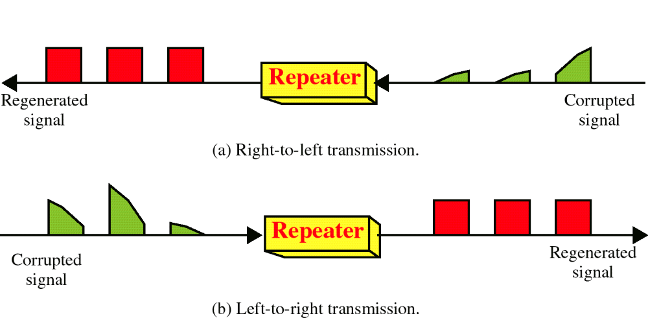
Function of a Repeater
WCB/McGraw-Hill
© The McGraw-Hill Companies, Inc., 1998

Slide 12
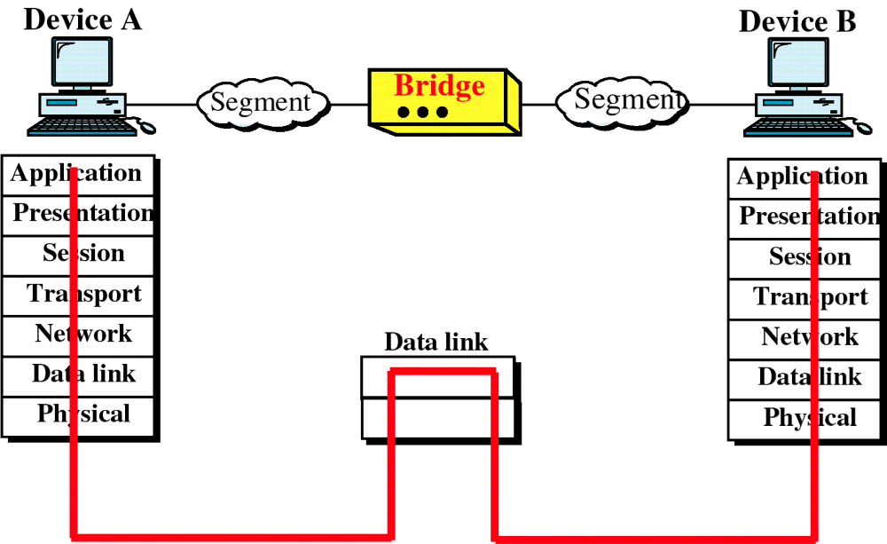
Bridge and the OSI Model

Slide 13
Bridges
In bus topology, a bridge is a traffic controller.
  It can divide a long bus into smaller segments so that each segment is independent traffic wise.
  The bridge uses a table to decide if the frame needs to be forwarded to another segment.
  With a bridge, two or more pairs of stations can communicate at the same time.

Slide 14
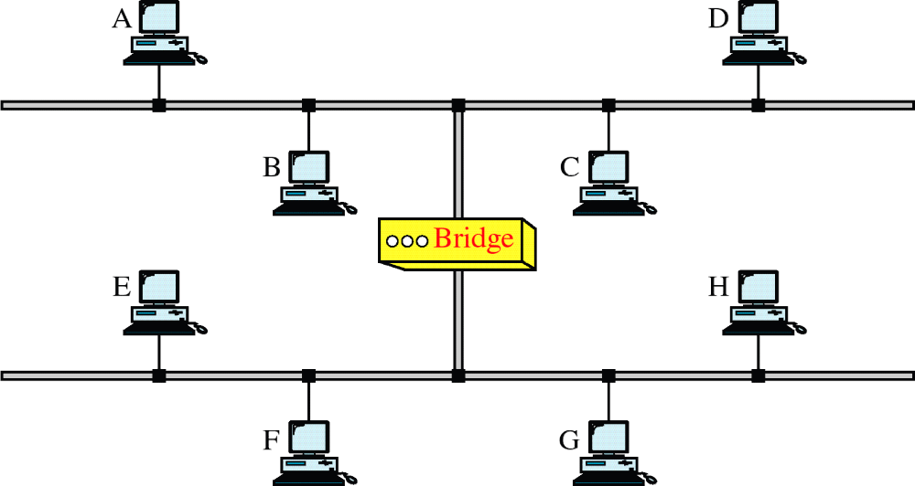
A Bridge

Slide 15
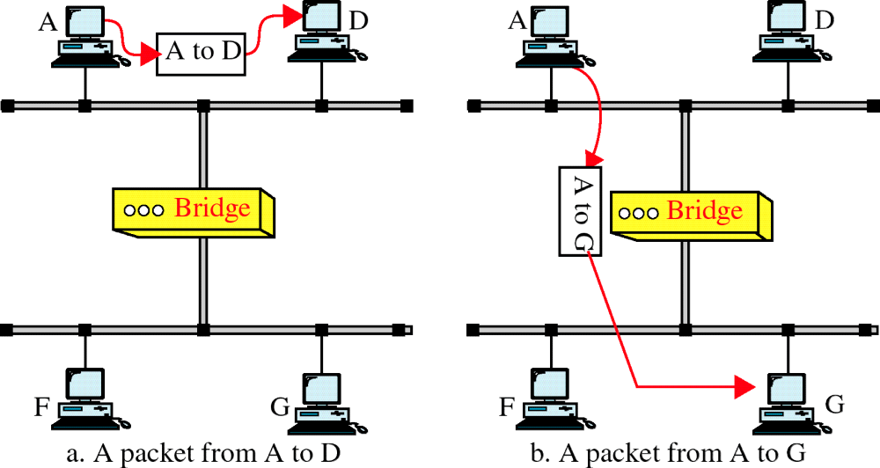
Function of a Bridge

Slide 16
Note
A bridge does not change the physical (MAC) addresses in a frame.

Slide 17

A learning bridge and the process of learning

Slide 18
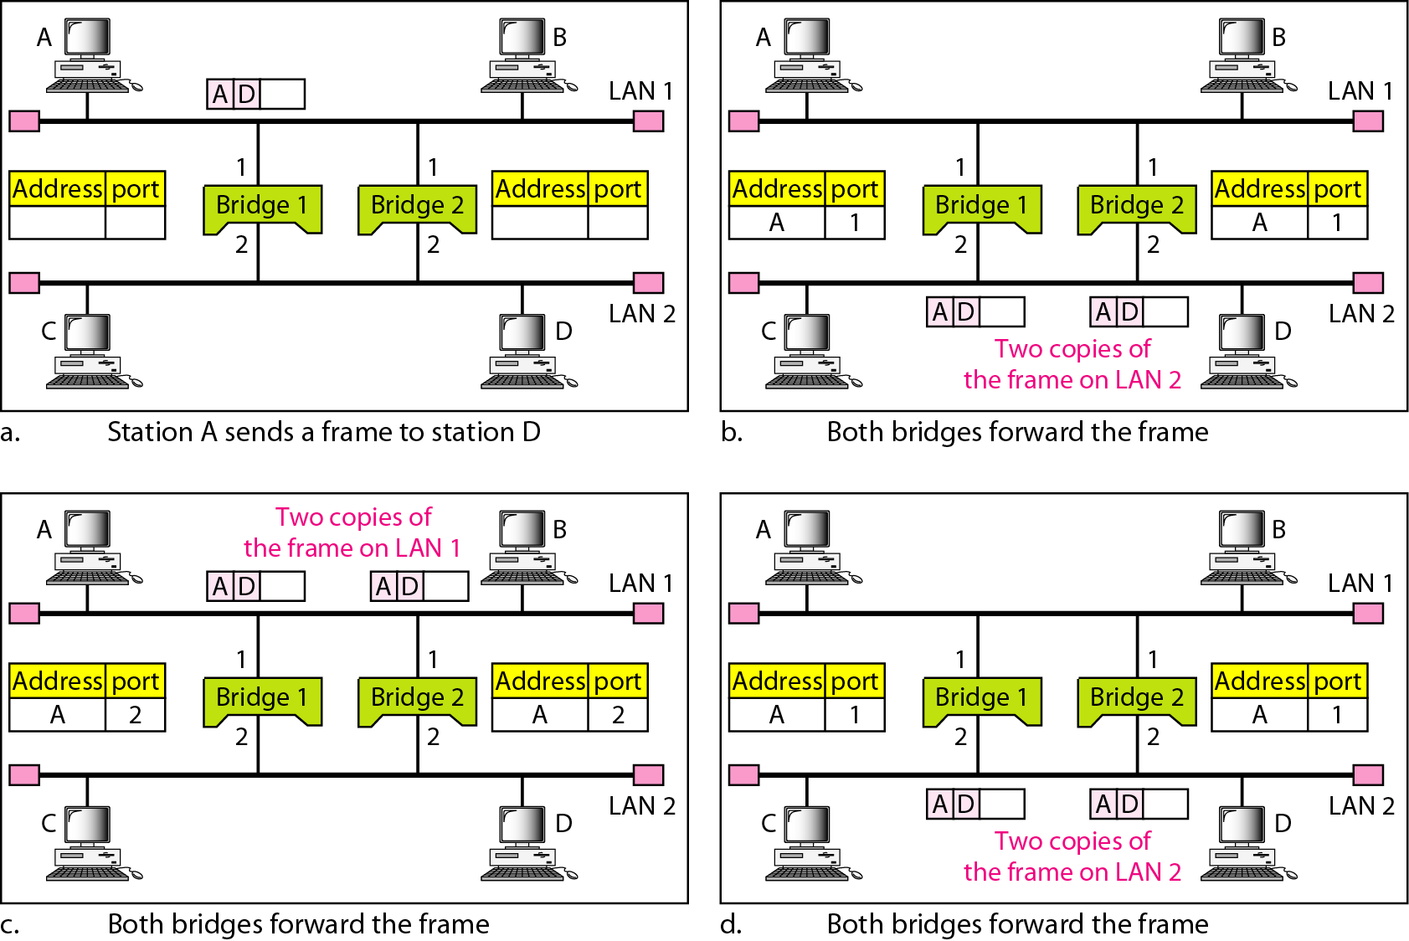
Figure 15.7 Loop problem in a learning bridge
15.<number>

Slide 19

Note:
Bridges operate at the first two layers
(physical layer and data-link layer) of the OSI model.

Slide 20
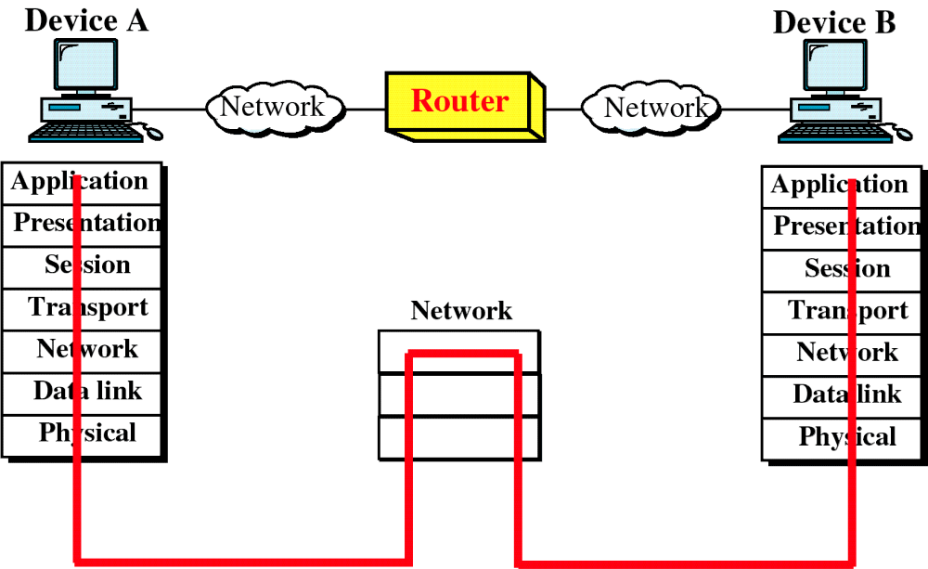
Router and the OSI Model

Slide 21
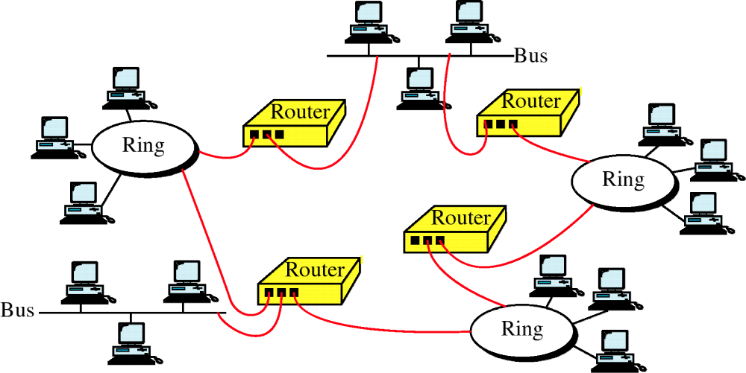
Routers in an Internet

Slide 22
Routers
Whereas a bridge filters a frame based on the physical address of the frame, a router routes a packet based on the logical address of the packet.
Whereas a bridge may connect two segments of a LAN, a router can connect two independent networks.

Slide 23
Note:
Routers operate at the first three layers
(physical, data-link, and network layer)
of the OSI model.

Slide 24
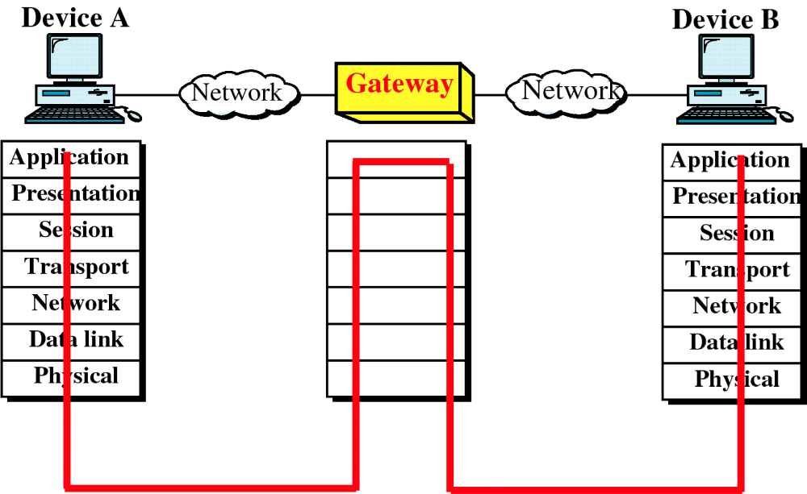
Gateway and the OSI Model

Slide 25
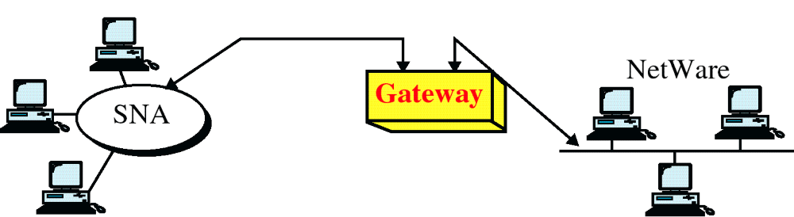
A Gateway

Slide 26
Gateways
A gateway is usually a computer installed with the necessary software.
Today the term gateway is used interchangeably with the term router. The distinction between the two terms is disappearing.

Slide 27
BACKBONE NETWORKS
A backbone network allows several LANs to be connected. In a backbone network, no station is directly connected to the backbone; the stations are part of a LAN, and the backbone connects the LANs.
Bus Backbone
Star Backbone
Connecting Remote LANs

Slide 28
Note
In a bus backbone, the topology
of the backbone is a bus.
15.<number>

Slide 29
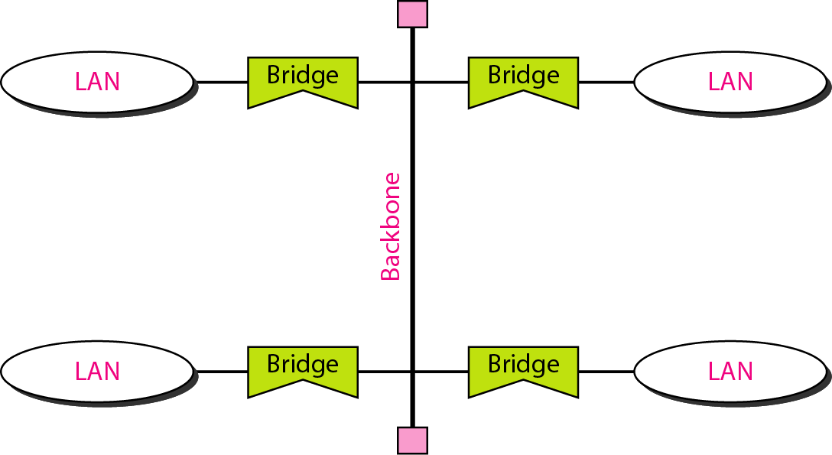
Bus backbone

Slide 30
Note
In a star backbone, the topology of the backbone is a star;
the backbone is just one switch.
15.<number>

Slide 31
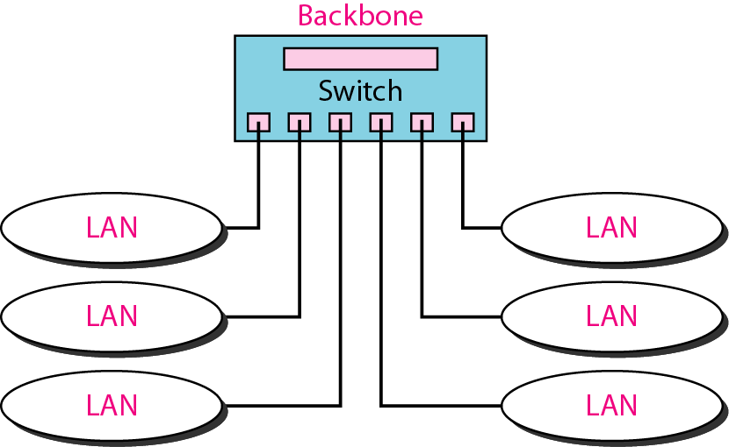
Star backbone

Slide 32
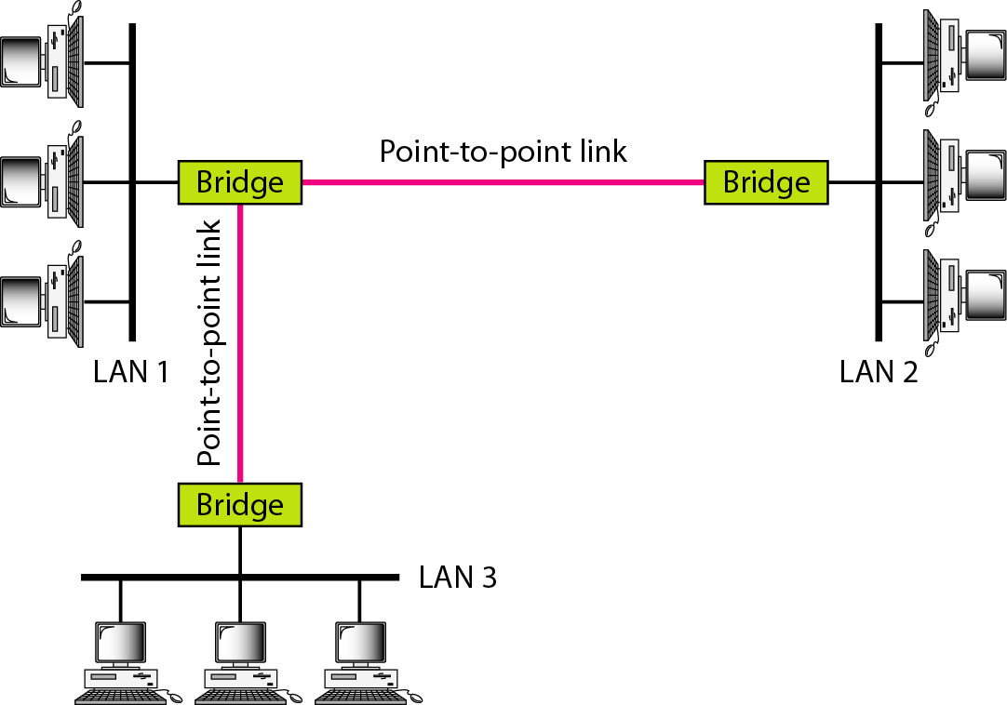
Connecting remote LANs with bridges

Slide 33
Note
A point-to-point link acts as a LAN in a remote backbone connected by remote bridges.

